Slide 1
Develop an App based Smart Meter Infrastructure Incorporating DSM Scenario
Presented By,
Mookul Paul (11501620012)
Nandini Chakraborty (11501620009)
Supervisor’s Name
MR. ARITRA GHOSH , ASSISTANT PROFESSOR

Slide 2
ABSTRACT
This project aims to create a smart meter-based app with advanced Demand Side Management (DSM) features. It helps users monitor, manage, and optimize their energy use in real-time. The app offers insights, encourages efficient consumption through load shifting, demand response, and tailored energy-saving tips. It empowers users to control usage, fostering a more sustainable grid and potentially cutting costs. The project involves backend integration, advanced algorithms, user-friendly interfaces, and thorough testing for functionality and reliability.

Slide 3
LITERATURE SURVEY
Rodrigues et al. [1]
Hardware used: Texas Instruments EK-TM4C1294, double f6150e (Protective relay test kit), Hall effect Sensor, Protest software. This system is an early stage of approach for the development of smart meter system. Being the early stage, it had many limitations as follows: High sampling time, Low accuracy in power calculation, No Data hub to avoid data loss, No Data logging system, No automation, No scheduler based load control, No demand side management system, Tested with test kit no real time test result, Used Decision tree algorithm for classification, Can be used only for analyzing power quality issues.
Avancini et al. [2]
Hardware used: MSP 430 (CT), TM4c, NodeMCU. The system is developed in the year 2020 with some upgrades to the previous system, but it is still not a perfect with some limitations as follows: Individual hardware for individual purpose increasing the costing of the system, High chance of data loss because of using multiple UART connection, High sampling time, Low accuracy in power calculation, No Data hub to avoid data loss, No Data logging system, no automation, no scheduler-based load control, No demand side management system.
Viciana et al. [3]
Hardware used: Current Transformer, Potential Transformer, STM32, NanoPI AIR, Lipo Battery. The system is developed from the latest available microcontroller, with the new sensors. The system still has many limitations, which are as follows: No Data hub to avoid data loss, No Data logging system, No automation, No scheduler based load control, No demand side management system, Tested with test kit no real time test result, Limited operation time due to use of battery.

Slide 4
DSM (Demand Side Management)
Demand Side Management (DSM) in power distribution refers to strategies and initiatives aimed at influencing and optimizing the electricity consumption patterns of consumers to achieve a more efficient and balanced energy system.
Peak Load Reduction
Time-of-Use (TOU) Pricing
Demand Response Programs
Load Shifting
Smart Metering and Automation
Energy Efficiency Promotion
Economic Savings

Slide 5
LOAD SHIFTING
Load shifting, also known as demand shifting or demand response, is a strategy used in the energy sector to manage electricity consumption patterns by encouraging consumers to shift their energy-intensive activities to different times of the day.
Types of Residential Loads :
Shiftable and non-shiftable appliances | Appliance’s Name | Energy Consumption(kWh)
Shiftable Appliances | Water Pump | 4
 | EV Charging | 5
 | Dish Washer | 1.4
 | Washing Machine | 2
Non-shiftable Appliances | Refrigerator | 1.5
 | Microwave Oven | 1.8
 | Air Conditioner | 12

Slide 6
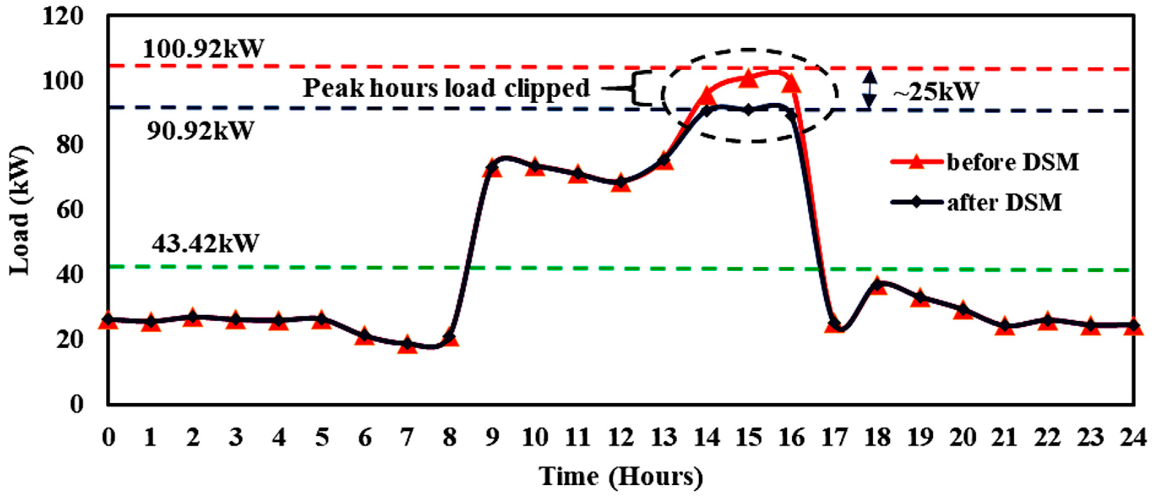
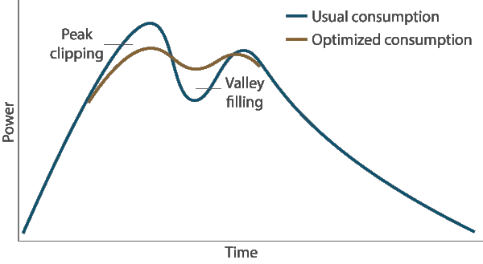
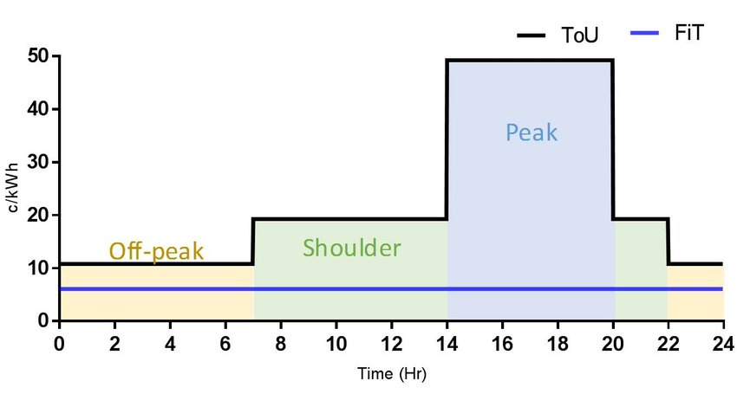
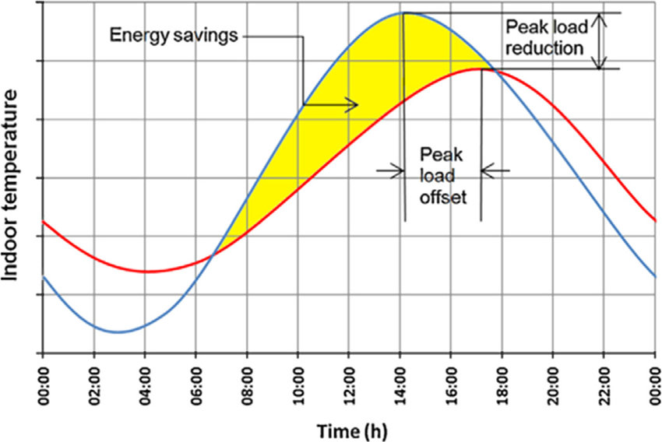
Different Methods of Load Shifting
The major modes of Load Shifting are as follows :
Peak Shifting
Peak Clipping
Valley Filling
Peak Clipping
Peak Shifting
Valley Filling
Tariff

Slide 7
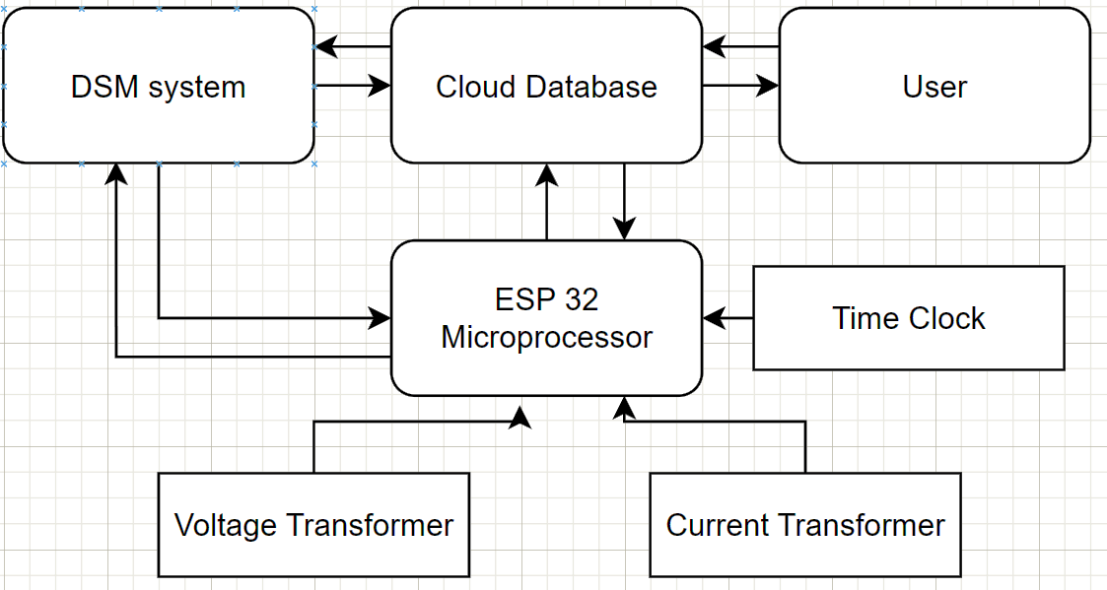
OUR APPROACH
Main target of the project
Develop a cheap smart system
DSM integrated system
IoT support with cloud based storage of data
Automation
User Friendly
Technology Stack
IoT (ESP 32)
Cloud
Arduino IDE
Java / Kotlin
HTML / CSS

Slide 8
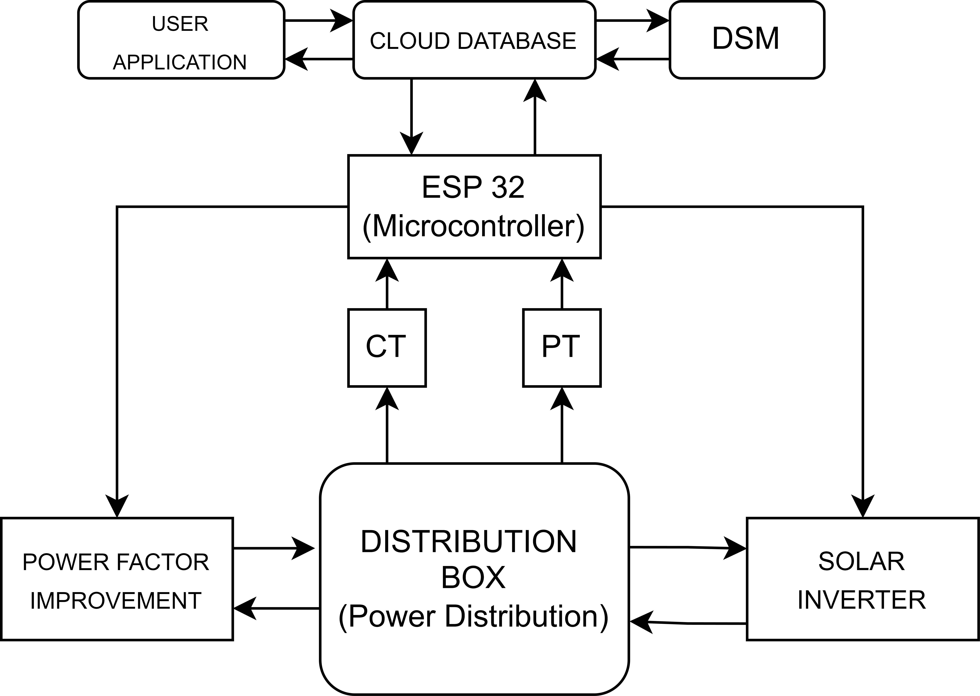
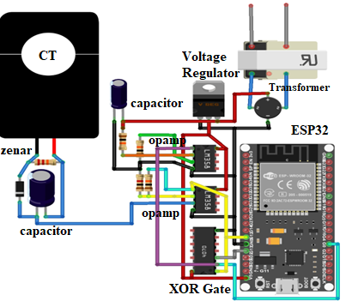
FLOW CHART & CIRCUIT DIAGRAM
FLOW CHART
CIRCUIT DIAGRAM

Slide 9
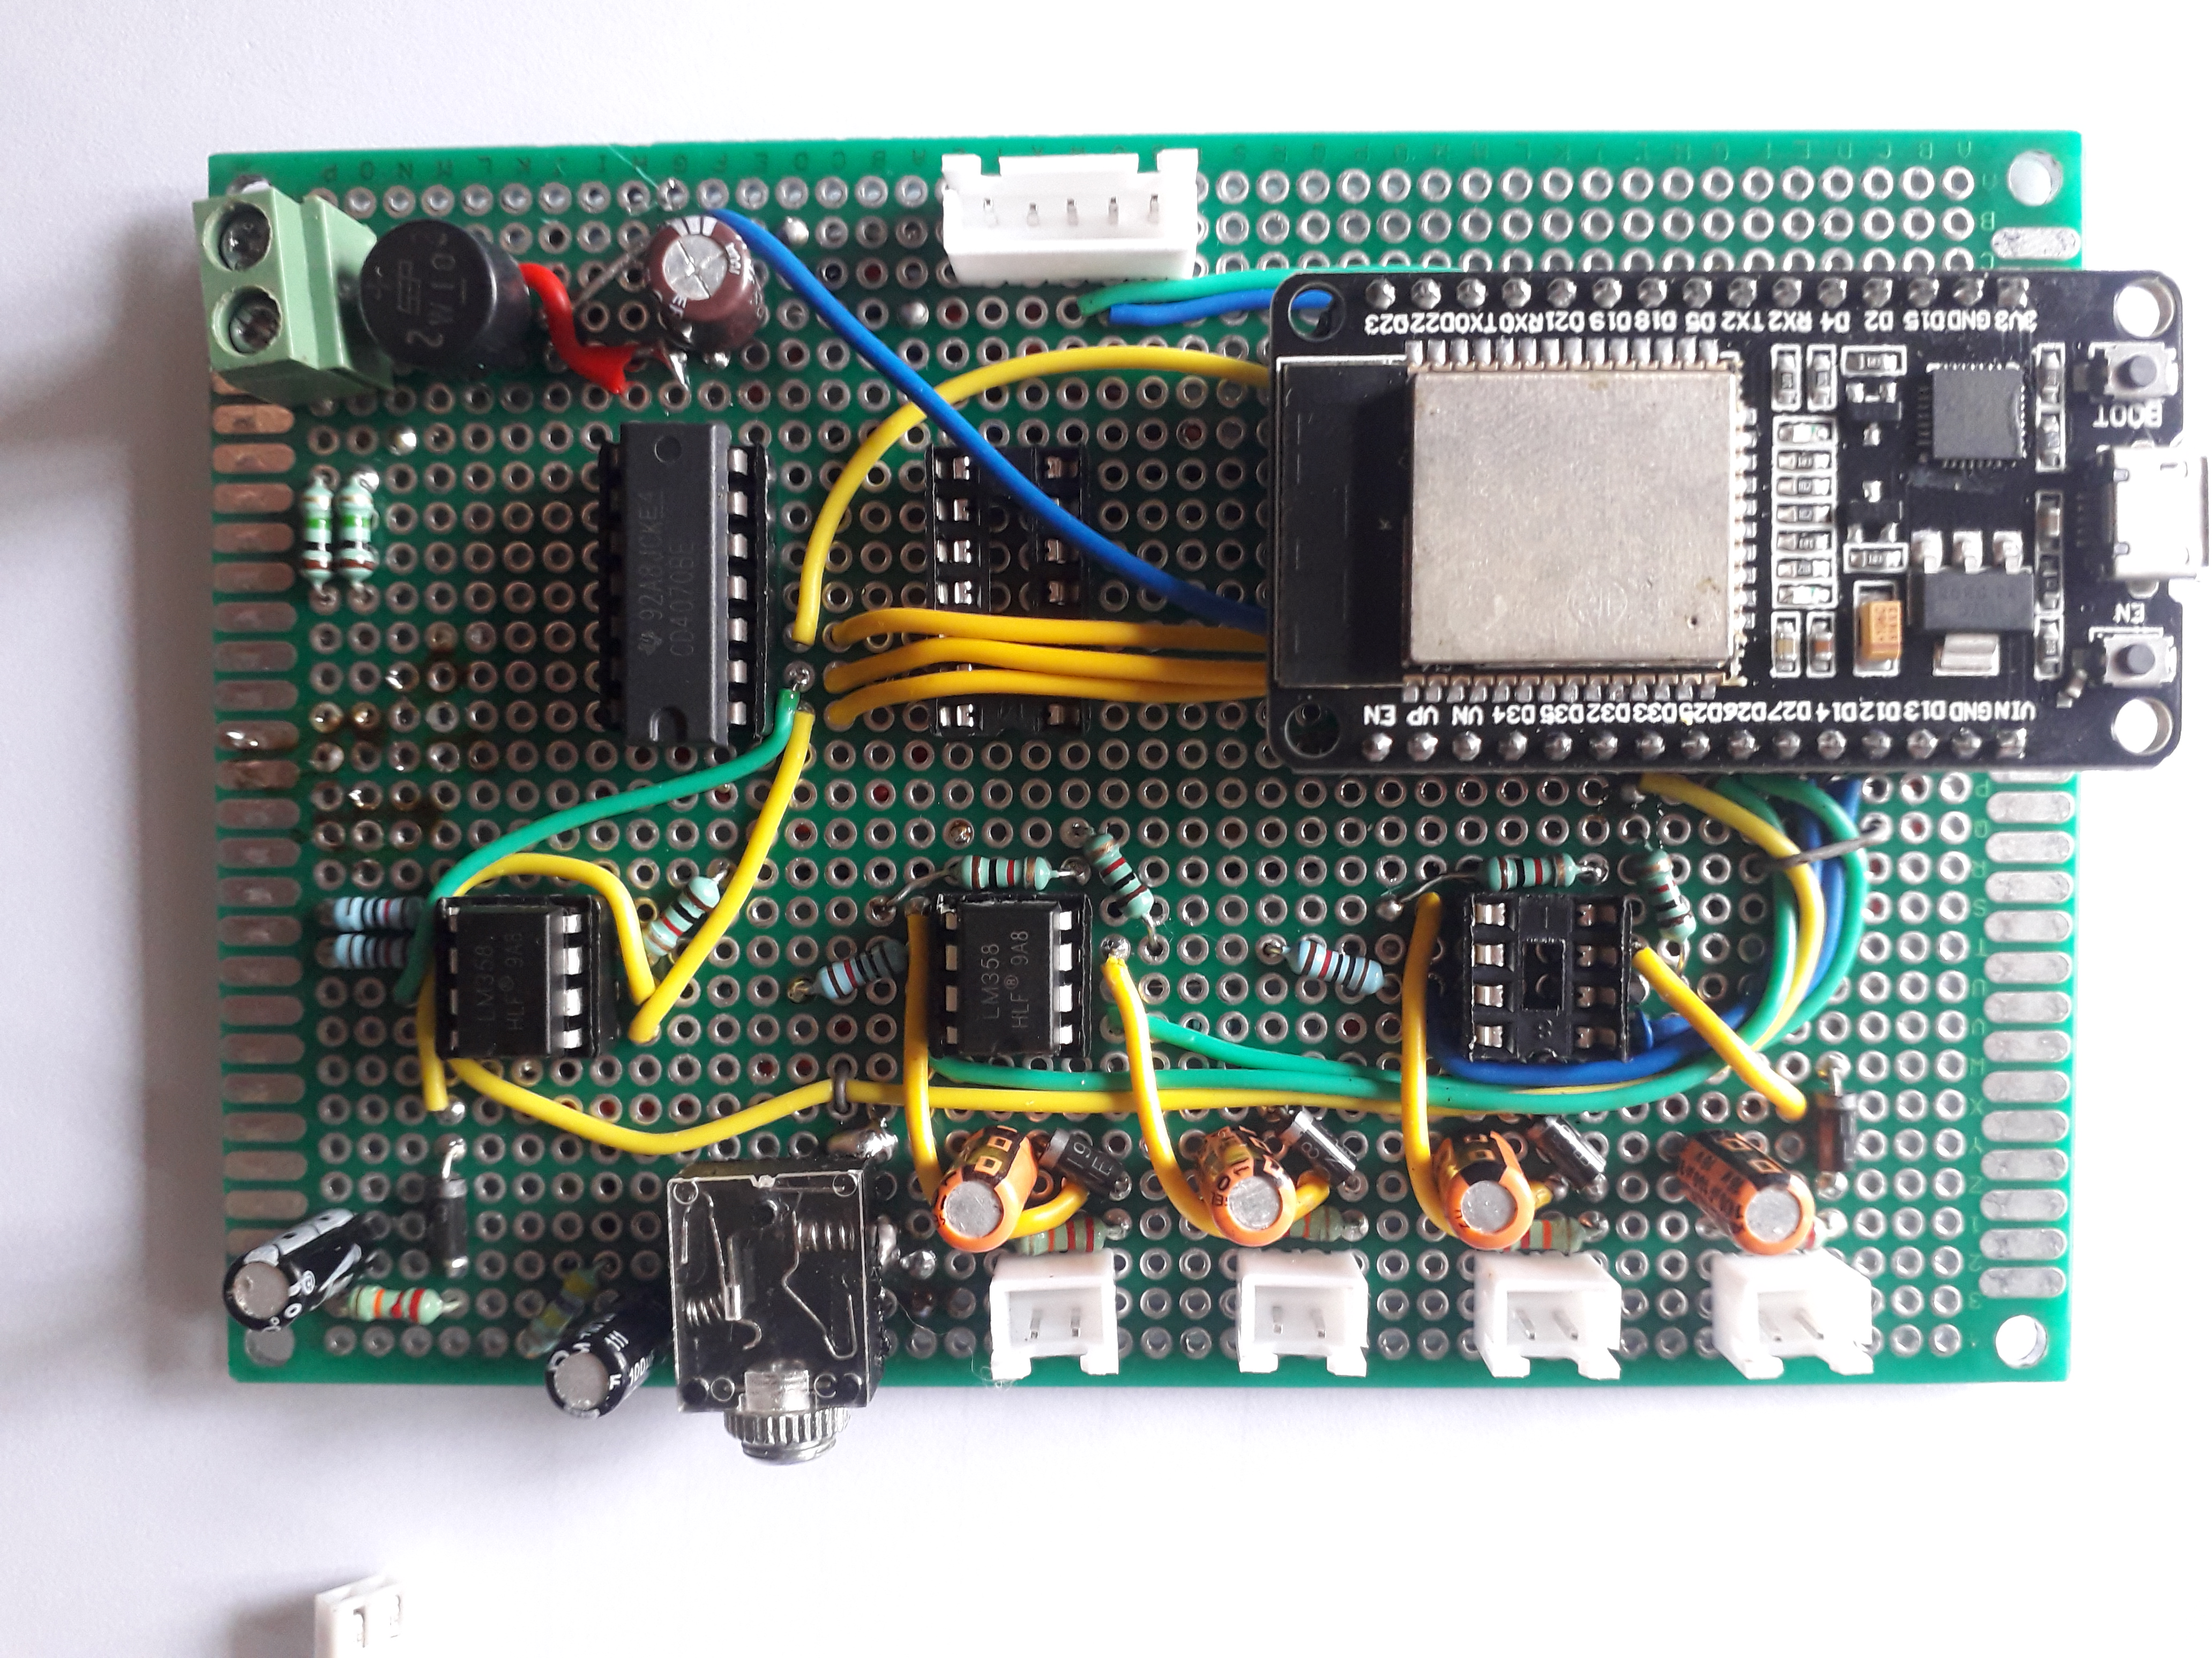
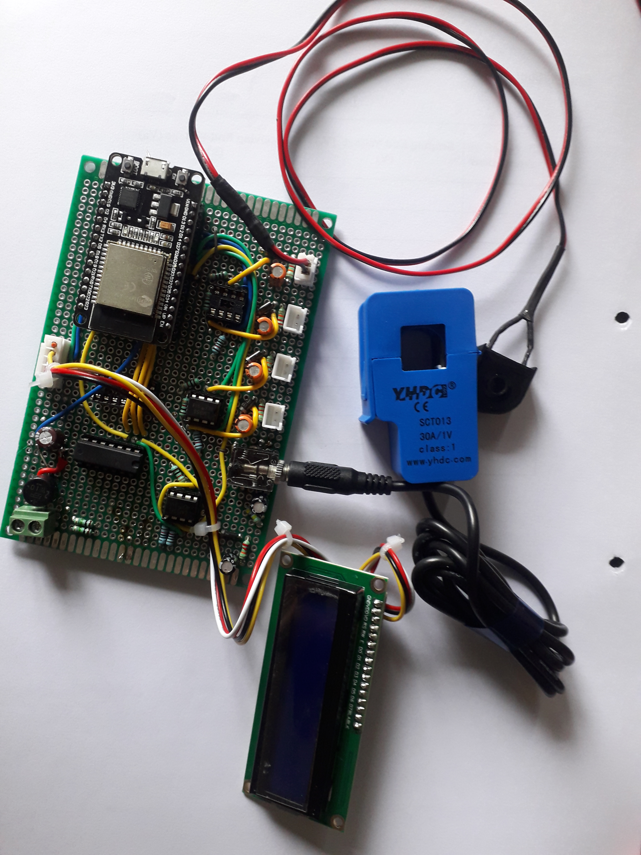
WORK DONE TILL NOW (NOT THE COMPLETE ONE)

Slide 10
TIMELINE
Mentioned below is the proposed timeline of our prototype development .
0th Review
10th August
2023
Primary Literature Survey and tentative title formation
Mid-Term Project Evaluation
14th-15th September 2023
Complete Literature Survey with hardware components identification
7th Sem Final Project Presentation
24th-25th November 2023
Primary Model preparation with App development
01
02
03
04
05
Mid-Term Project Evaluation
2nd-3rd February
2023
Completion of Project with Validation and Troubleshooting
04
02
03
Final Project
Pesentation
15th-16th April
2024
Paper Writing with Result analysis
05
01

Slide 11
REFERENCES
Jasim, Ali M., et al. "Efficient optimization algorithm-based demand-side management program for smart grid residential load." Axioms 12.1 (2022): 33. [1]
Guerrero, Jaysson, Archie Chapman, and Gregor Verbic. "A study of energy trading in a low-voltage network: Centralised and distributed approaches." 2017 Australasian Universities Power Engineering Conference (AUPEC). IEEE, 2017. [2]
Dharani, Rajavelu, et al. "Load shifting and peak clipping for reducing energy consumption in an Indian university campus." Energies 14.3 (2021): 558. [3]
Akeiber, Hussein, et al. "A review on phase change material (PCM) for sustainable passive cooling in building envelopes." Renewable and Sustainable Energy Reviews 60 (2016): 1470-1497. [4]
https://energycentral.com/c/em/key-demand-response-proper-customer-engagement [5]

